Slide 1
More and more Serve !
We just serve for the others without any expectation as can as we possible !

Slide 2
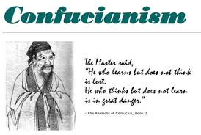
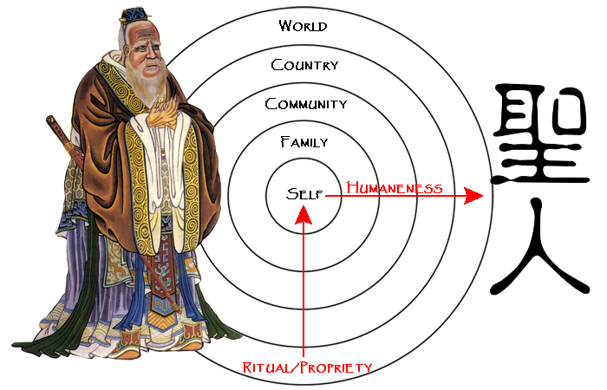
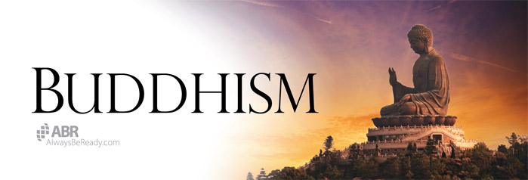
Chinese medicine is created by Three Philosophical concept
󰡔三敎平心論󰡕｢序｣ “以佛治心. 以道治身. 以儒治世.
誠知心也身也世也. 不容有一之不治. 則三敎豈容有一之不立.”
If you cultivate your morals , you will manage your family well ,govern your nation, can make this world peaceful
Ethical-sociopolitical teachings
종교와 의학은 전체를 이루려는 동일한 목적을 지닌다. 聖(holiness)과 치유
(healing)가 전체성(wholeness)이라는 개념에 뿌리를 둔 같은 어원을 지닌 것
철학과 과학
파동과 물질
퀀텀과 원자
Nirvana, Samsara
A state of extreme peace and happiness
“Cycle of Existence"
Nature, Cycle, 无为而治
When I was twenties, I had studied Chinese philosophy.
Since I was forties, I have been studying Chinese Medicine.
Living in harmony with the Tao

Slide 3
Dr. Jinman Kim
Dr. of Traditional Chinese Medicine & Acupuncturist
Earned a bachelor’s degree in Chinese Ancient Philosophy / Chinese Literature at Korea Konkuk University
Attended a Master’s course in Chinese Ancient Philosophy from Chinese Culture University in Taiwan
Attended a Nutrition & Diet Therapy Aromatherapy course from Akademie Gesundes Lebenin Germany
Graduated from Shanghai University of Traditional Chinese Medicine
Worked at Longhua Hospital in Shanghai, China
Obtained Tuina therapist certification
Obtained Chinese doctor certification
Obtained Chinese Practicing doctor certification
I’m very happy to be here and have a chance to share Tung style acupuncture.
I am not intelligent, but I want to share my experience and its theoretical system with you and try my best.
The theoretical system is reconfigured based on its my own experience and learning.
Notes:
I’m very happy to be here and have a chance to share Tung style acupuncture.
I am not intelligent, but I want to share my experience and its theoretical system with you and try my best.
The theoretical system is reconfigured based on its my own experience and learning.

Slide 4
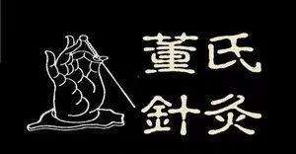
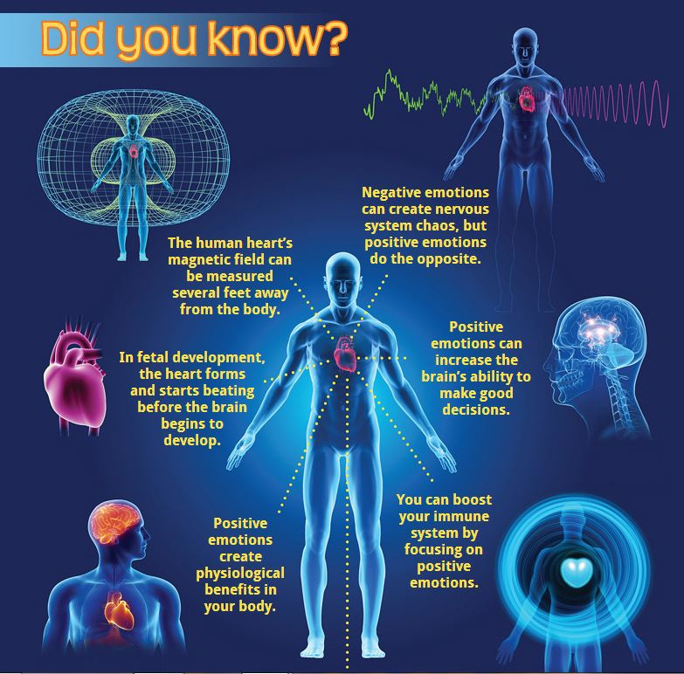
Tung Style Acupuncture
上工守神，下工守形

Slide 5
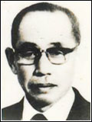
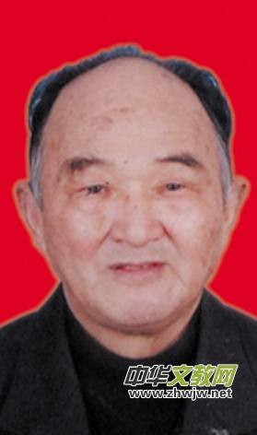
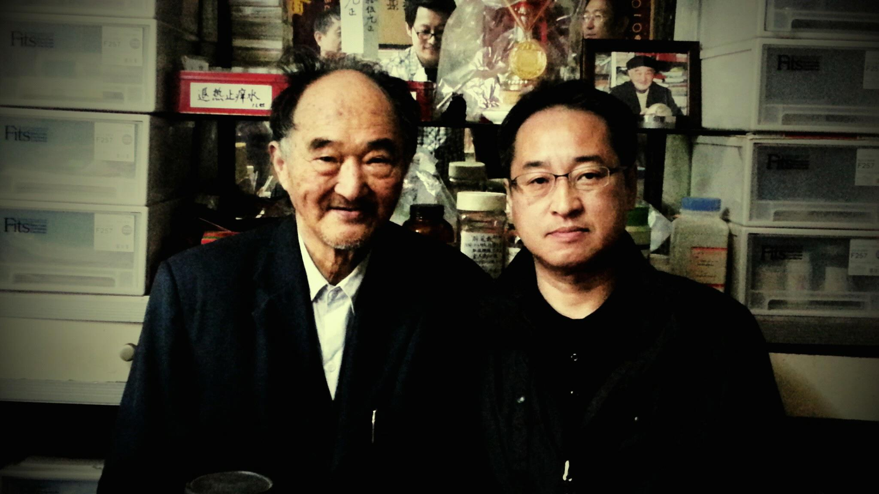
董景昌先生(1916-1975)
山東平度縣人，始自其先祖曾以針灸醫術救人，氏家道小康，十八歲在原籍設立針灸診所，服務桑梓，不計診費，抗戰時期，離鄉從戎，勝利後解甲歸里，後在青島設立針灸診所。卅年來診治病患近四十萬人
马基平先生（1928年出生）
上海人.从事医药工作60余年。1989年退休后开设中医门诊。收入了 2001年版的 ”世界名人錄“，2010年版的 ”創新中國“ 等書目。每天看診一百多人，幾乎屬於全科治療。最常見的還是打工者，此外還各界名人和政府領導，所有的人不論身份在這裡都是排隊候診。
Mr. Dong Jingchang (1916-1975)
He, from Pingdu County, Shandong Province, began to save people’s lives with acupuncture and moxibustion. His family was well-off and he established an acupuncture clinic in his hometown at the age of 18, serving the community without any charges or fees. During period of war, he left his hometown and became a soldier. After the victory, he set up an acupuncture clinic in Qingdao. Nearly 400,000 patients were diagnosed and treated by him in the following year .
Mr. Ma Jiping (born in 1928)
He was born and raised in Shanghai and engaged in medical job for more than 60 years. After retiring in 1989, he opened a Chinese medicine clinic. What he has done has been recorded in 2001 edition of the “International Who's Who“, the 2010 edition of "Innovative China" and other bibliographies. More than 100 people are seen every day and are almost fully recovered. The most common patients are still migrant workers in addition to celebrities from all walks of life and government leaders. All of whom are waiting in line here regardless of their status.

Slide 6
Contents
Five characteristics
Features of the acupuncture point method
Features of the puncture method
Features of mental cultivation methods
Treatment characteristics
Diagnosis
Main Acupoint
Treatment principles
Scientific basis of Chinese Medicine
目录
五大特色
（一）穴法特色
（二）针法特色
（三）心法特色
（四）治疗特色
（五） 诊断
常用要穴
治疗原则
科學的類似性

Slide 7
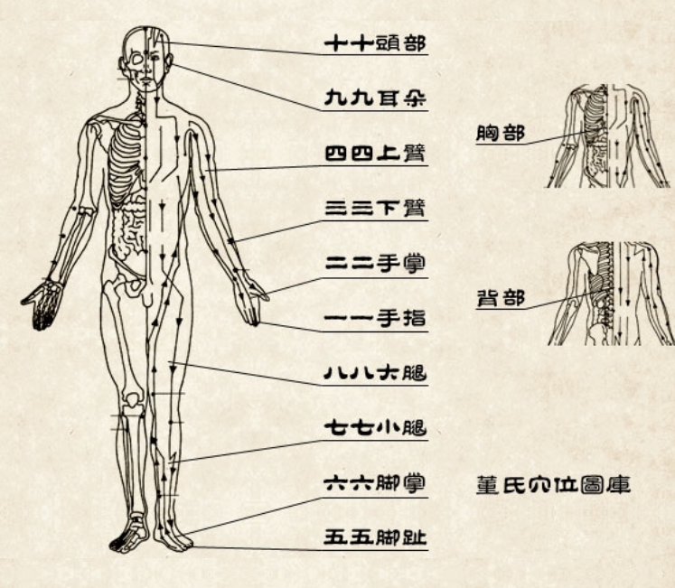
（一）穴法特色
董氏奇穴分布在手指、手掌、下臂、上臂、足趾、足背、小腿、大腿、双耳、头面以及前胸、后背等十二个部位，脉络清晰，有章可循
（1） Features of the acupuncture point method
Tung style acupuncture points are distributed in the finger, palms, lower arms, upper arms, toes, insteps, calves, thighs, both ears, head, front chest, back and other 12 parts. The channels are clear and there are rules to follow.

Slide 8
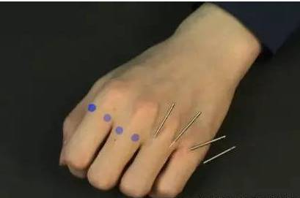
1. 倒马针法
（二）针法特色
倒马针法即用二或三根針來治療。馬跑得很快，即迅速之意，取馬為名亦有速效之意。董氏倒馬針法可使各臟腑間起整體協調作用，對於治療的效果更能強化提高，加強患者的針感，直通三焦，故其效果當然較其他針刺為強。
2. Features of the puncture method
1. “Dao Ma” (means Inverted horse) puncture method
“Dao Ma” puncture method is treated with two or three needles. The horse runs very fast, which means quick. The use of horse in name also means quick-acting. Dong's inverted horse acupuncture method can improve the overall coordination function between the organs and the effect of treatment can be strengthened and enhanced. The patient's needle feeling is strengthened. The triple warmers are straight through, so the effect is of course stronger than other acupuncture method.

Slide 9
倒马针法治疗的特性
1 针通三焦：用三根針同時治療，其療效可通三焦，治療範圍可達所有臟腑，不像傳統針法，因此，針效來得強的原因。
2 整体疗法：疾病的發生，並非單純只是一臟一腑的病變，乃是諸臟腑間皆有整體性的關連，故倒馬針法便具有整體治療的特點，對循環、呼吸、消化、生殖、排泄等，常做整體性的治療與調整，使治病的療效發揮達到最高的針效。Fractal Theory
3 疗效特強：若利用倒馬針法二或三根針，其效果常較迅速，針感較強，且療效亦較佳。
Features of Dao Ma puncture method
1. One needle through triple warmer: Using three needles at the same time, its efficacy can pass triple warmer. The treatment range can reach all the organs, unlike the traditional puncture method. Therefore, the effect of the puncture method is strong.
2. Holistic therapy: The occurrence of disease is not just a disease of a single viscera or organ, but holistic connection of all the viscera, so the Dao Ma puncture method has overall treatment for circulation, respiratory, digestion, reproduction. Excretion, etc. Doing a holistic treatment and adjustment regularly can make the efficacy of treatment to achieve the highest puncture effect.
3 The curative effect is very strong: if Dao Ma puncture method is used by 2~3 needles, the effect is often rapid, the needle feeling is strong and the curative effect is also better.

Slide 10
倒马针法治疗的特性
4 特重区段：倒馬針法不重經絡，特別重視區段的取穴方法，亦是異於傳統針法的一大特點。其穴位區分為一一～十十部位，每個部分的區段，皆可獨立成一系統，由局部代表人的整體，其各區段內，皆有倒馬針法的穴位，例如四四部位的天宗、地宗、人宗，七七部位的三重一、二、三穴，八八部位的上三黃，十十部位的正會、前會、後會等。
5 手法简明：董氏針灸不講古傳各種，彈、啄、飛、搯等手法，不講手法技術上的補瀉，針法簡單明確，與傳統大談補瀉、手法，於臨床施治上常有實際與理論未能結合不易掌握.
6 危险性低：董氏倒馬針剌治療法，取穴位置大都以四肢、頭部、耳部為主，不在腹部、胸部取穴，避開了人體的一些危險臟器.
The features of Dao Ma puncture method treatment
4. Extra-heavy section: The Dao Ma puncture method does not emphasize the meridian, but it pays attention to the method of acupoint selection in the section, which is also very different from the traditional acupuncture method. The acupoints are divided into one one to ten ten parts and each part can be independently formed into a system. The local section can represent the whole body. Each section has Dao Ma puncture method points, such as the four four parts Tianzong, Dizong, Renzong; the triple one, two, three points of the seven seven parts, the shang san huang of the eighty-eight parts, the tenth part of the zhenghui, qianhui, houhui and so on.
5. Simple method: Dong's acupuncture method does not talk about all kinds of ancient transmissions. It does not talk about the technique of reinforcing and reducing method. The puncture method is simple and clear.
6. Low risk: The location of the acupoints of Dong's Dao Ma acupuncture treatment method are mostly based on limbs, head and ears, not in the abdomen and chest, avoiding some dangerous areas of the human body.

Slide 11
2. 动气针法
（二）针法特色
对侧取穴扎針後的同時，患部導引運動，以引導針氣平衡行氣至患部，要患者主動運動患部，調勻呼吸，觀想患部酸痛逐漸減輕、慢慢消失。所以不只是光叫患者運動患部，更須配合呼吸與意念，尤其意念的觀想很重要。
（2）Features of the puncture method
2. Dong Qi (means moving energy)puncture method
After needles are inserted, the affected part guides the movement at the same time in order to guide the needle to balance the energy to the affected part. The patient should actively move the affected part, breathing steadily. The pain in the affected part gradually reduce and slowly disappear. Therefore, patient not only exercises the affected area, but also cooperate breathing with mind together. Especially, the idea of ​​the mind is very important.

Slide 12
（三）心法特色
1、全息通应：整体中任何一个独立部分，都影缩着整体的信息Fractal Theory
2、同气相求：以骨治骨，以筋治筋，以肉治肉，以脉治脉，以皮治皮。如治疗各种骨刺，必须贴骨扎针方有特效
3、脏腑别通(医学入门) ： 脏腑气化相通。如重子、重仙在肺经上，主治膀胱经之背痛；中白、下白在三焦经上，补肾作用极佳；木穴在大肠经上，治肝火旺极具特效；火包穴在胃经上，透过胃与心包通，治心绞痛特效
（3） Features of mental cultivation methods
1. Holographic connection: any independent part of the whole body shadows the overall information.
2. Birds of a feather flock together : treat bones with bone, treat tendon with tendon, treat muscles with muscles, treat pulse with pulse, treat skin with skin. For example, Bone tie needle method is used to treat bone spur.
3. Organs connection: Qi of organs are connected. For example, Zhongzi is located at lung meridian to treat back pain; Zhongbai and Xiabai are located at triple energizer to improve kidney function; Muxue is located at large intestine, which has great effects on liver-heat; Huobao is located at stomach meridian, which is effective for treating angina.

Slide 13
（四）治疗特色
“董氏正经奇穴治疗特色是取穴少，见效快，本人的治疗经验；
各种痛症、面瘫、偏头痛，眼散光，项强，落枕，肘关节痛，五十肩，膝关节炎，脚扭伤，腰扭伤，坐骨神经痛，鼻炎、哮喘、耳鸣、耳聋、失眠，高血压，糖尿病，肝癌，肝炎，食滞，便秘，胃炎，胃癌，甲状腺肿，皮肤过敏，膀胱炎，前列腺肿大，带状疱疹、赤白带，月经不调，不孕症、妇科病等。如重子穴治久年背痛立竿见影；又如肾关穴配灵骨穴治尿频；妇科穴治不孕症；驷马穴治过敏性鼻炎及多种皮肤病；正脊穴及上三黄治各种骨刺；下三皇治糖尿病；侧三里、侧下三里治面瘫等
（4） Treatment Characteristics
The characteristics of Tung style acupoint treatment is to use a small number of points, quick effect from my own treatment experience;
Various pain, facial paralysis, migraine, eye astigmatism, stiff neck, elbow pain, adhesive capsulitis, arthritis, sprained foot, lumbar sprain, sciatica, rhinitis, asthma, tinnitus, deafness, insomnia, hypertension, diabetes, liver cancer, hepatitis, food stagnation, constipation, gastritis, stomach cancer, goiter, skin allergies, cystitis, prostate enlargement, herpes zoster, red leucorrhea, irregular menstruation, infertility, gynecological diseases, etc. For example, Zhongzi acupoints treat long-term back pain; Shenyu acupoints treat urinary frequency; gynecological acupoints treat infertility; Sima acupoints for allergic rhinitis and various skin diseases; Zhengji acupoints and Shangsanhuang acupoints treat bone spur ; Xiasanhuang treat diabetes; Ce san li, Ce xia san li treat facial paralysis, etc.

Slide 14
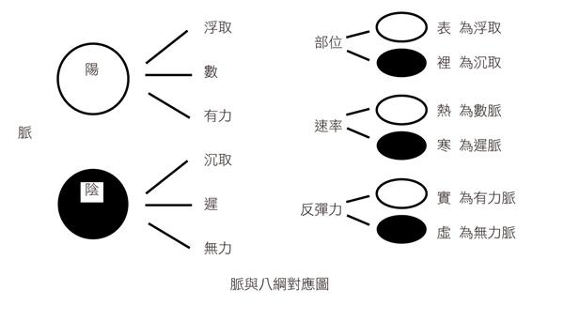
（五） 诊断； 必须与诊断相配合, Diagnosis; must cooperate with the diagnosis
司外揣内 (Governing exterior to infer interior)
病因
外因 ；風寒署濕燥火
內因 ；遺傳因素
精 ；飲食
气 ；勞逸
神 ；七情
Cause of the disease
External cause : wind, cold, summer-heat, dampness, dryness.
Internal cause : Genetic factors
Essence: Diet
Energy: Work and rest.
Spirit: Seven emotions.
脉诊
阴阳 ； 左右
表里 ； 浮沉
寒热 ； 迟数
虚实 ； 不足有余
Pulse diagnosis
Yin yang ; Left right
Exterior Interior ; floating deep
Cold heat ; Slow rapid
Deficiency Excess
诊断
陰 ; 陰虛, 血瘀, 痰濕, 濕熱
陽 ; 陽虛, 氣虛, 氣鬱
Diagnosis
Yin ; Yin deficiency, Blood stasis, Phlegm-dampness, Damp and hot
Yang ; Yang deficiency, Qi deficiency, Stagnation of qi

Slide 15
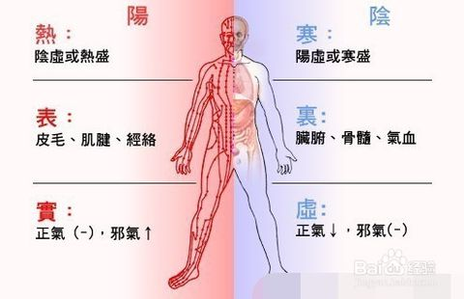
八綱辨證, Eight principal syndrome differentiation
Relative balance between
Yang(+) and Yin(-)
Moderate
Fever and Cold
Exterior and Interior Relation
Excess and Deficiency

Slide 16
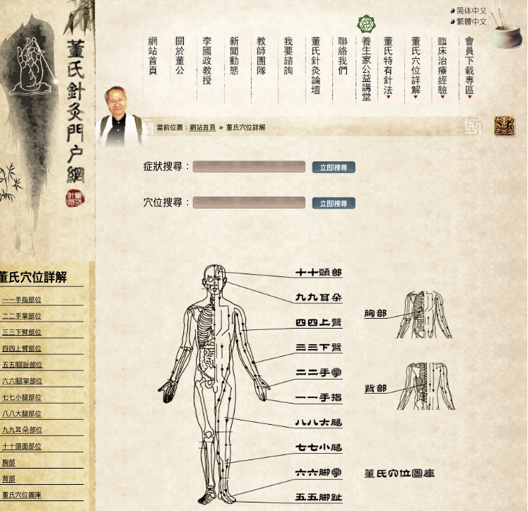
常用要穴
Main Acupoint
http://www.tungs.net.cn/zh-tw/

Slide 17
For English, see this book
Chapters:
1. The Basics
2. Dao3 Ma3 Points
a. Region One-One Points on the Thumbs and Fingers
b. Region Two-Two Points on the Palm and Dorsum of the Hand.
c. Region Three-Three Points on the Antebrachium
d. Region Four-Four Points on the Brachium
e. Region Five-Five Points on the Plantar Surface of the Foot
f. Region Six-Six Points on the Dorsum of the Foot
g. Region Seven-Seven Points on the Leg
h. Region Eight-Eight Points on the Thigh
i. Region Nine-Nine Points on the Ear
j. Region Ten-Ten Points on the Head
k. Region Eleven-Eleven Points on the Back
1. Region Twelve-Twelve Points on the Chest and Abdomen
3. Suggested Therapeutics
a. Head
b. Stroke
c. Ophthalmology
d. Otology
e. Oral
f. Rhinology
g. Face
h. Laryngology
i. Orthopedics (General) .
j. Neck, Back, and Shoulders
k. Upper Extremities .
1. Lower Extremities
m. Chest (General)
n. Pulmonology
o. Cardiology
p. Abdomen (General)
q. Liver and Gallbladder
r. Pancreas
s. Gastrointestinal t. Urology
u. Gynecology...
v. Andriatrics
w. Pediatrics .
x. Dermatology..
y. Miscellaneous.
Appendices:
1. Palmar Diagnosis
2. Extra Points
3. Blood ‘Letting’
4. Reaction Area to Dao3 Ma3 Group
5. A Guide to Hanyu Pinyin Pronunciation.
6. Quick Reference Dao3 Ma3 Groups
7. Disorder to Dao3 Ma3 Group
Point Index...
Bibliography.

Slide 18
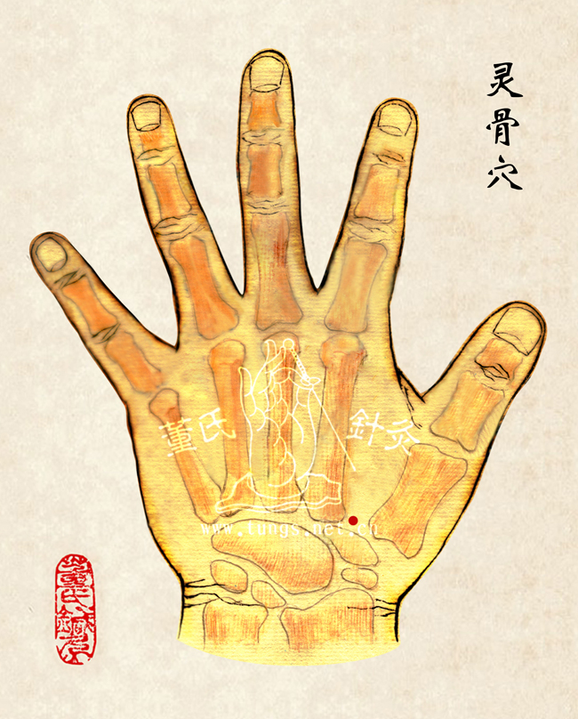
定位；第一掌骨與第二掌骨接合處。 距靈骨穴一寸。 主治；溫陽補氣要穴。肺機能不夠之坐骨神經痛、腰痛、腳痛、半面神經麻痹、半身不遂、月經不調、經閉、經痛、難產、背痛、耳鳴、耳聾、偏頭痛、腸痛、頭昏腦脹。
灵骨 大白
Ling Gu Da Bai
Ling2 Gu3 [ML22.05/RT p.14 ‘Spirit Bone’] - This point is located on the dorsum of the hand, in an area known as the ‘Hu3 Kou3’, i.e. the region between the first and second metacarpal bones. The point is found at the articulation of the bases of the first and second metacarpal bones proximal to LI-4who. When needling this point, one must locate and protect the radial artery where it pierces the first dorsal interosseous muscle.
Major functions； Acupoint of Warming yang to supplement Qi。Sciatica of lung deficiency syndrome、Back pain、Leg pain、Bell’s palsy、Partial paralysis、Menstrual disorder、Menopause、Menstrual pain, Difficult delivery、Ear noise、Deafened、Migraine、Intestinal pain、Dizzy head。

Slide 19
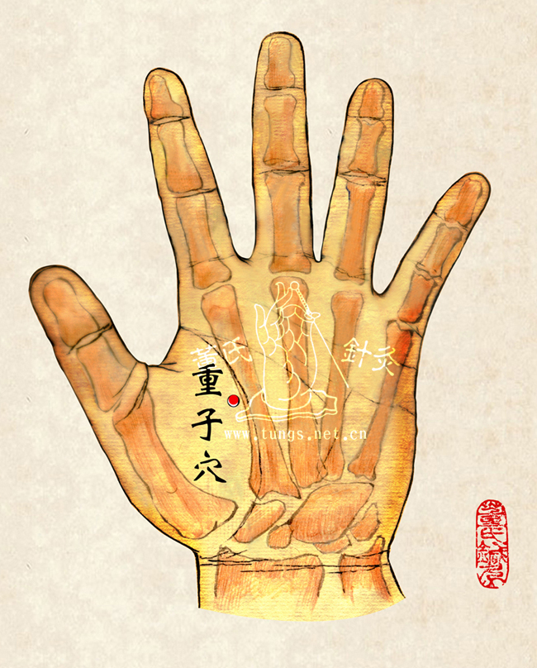
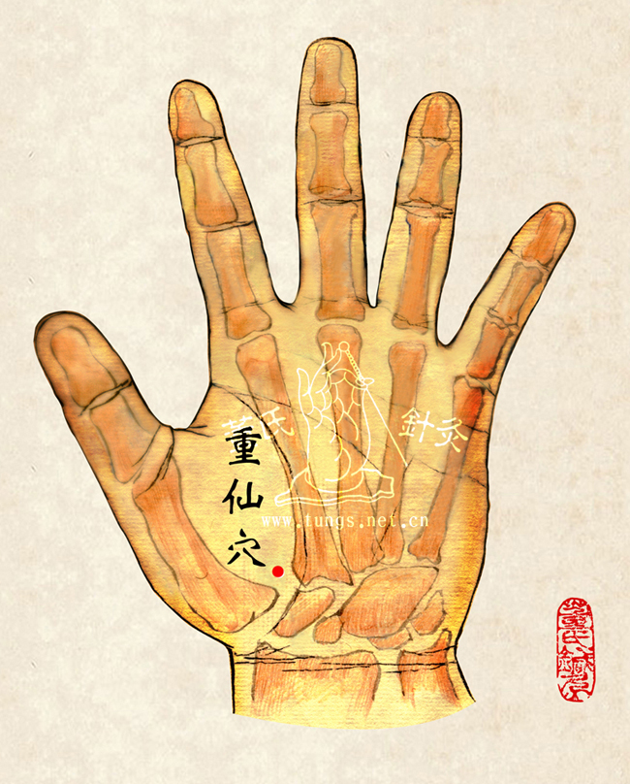
定位 ；手掌虎口下一寸，大指掌骨間。與手背靈骨穴相通。 主治 ；背痛、感冒、肺炎、咳嗽、氣喘。
重子 重先
Zhong Zi Zhong Xian
Major functions ；Back pain、Cold、Pneumonia、Cough、Asthma。

Slide 20
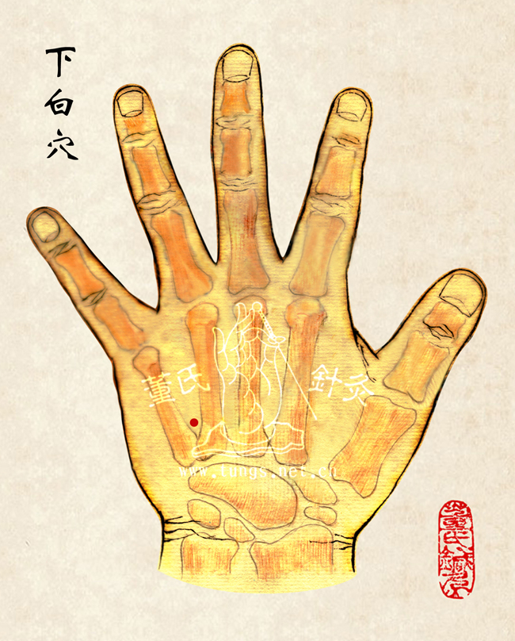
定位；手背第四掌骨與第五掌骨間，與十四經中渚穴相差五分。 液門穴下五分 主治；腎病之腰痛、腰酸、背痛、頭暈、散光、乏力、腎臟之坐骨神經痛、足外踝痛、四肢浮腫。
中白 下白
Zhong Bai Xia Bai
Major functions ；Low back pain in kidney disease、Soreness of waist、Backache、Dizziness、Astigmia、Lacking in strength、Sciatica of kidney、Foot malleolus pain、Swelling of the extremities。

Slide 21
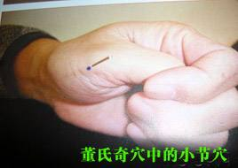
定位；赤白肉际到第二掌骨之间取一个最痛压痛点。 主治；脚踝扭伤及疼痛特效穴
小节
Xiao Jie
Major functions ；Special effect acupoint for Ankle sprain and pain

Slide 22
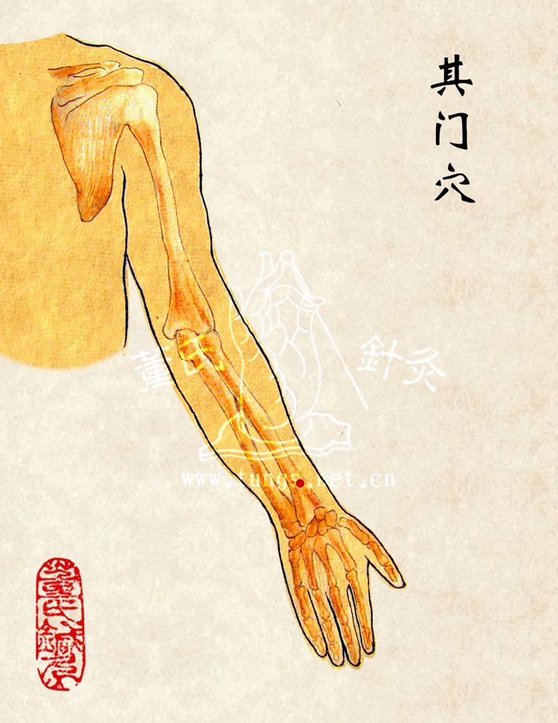
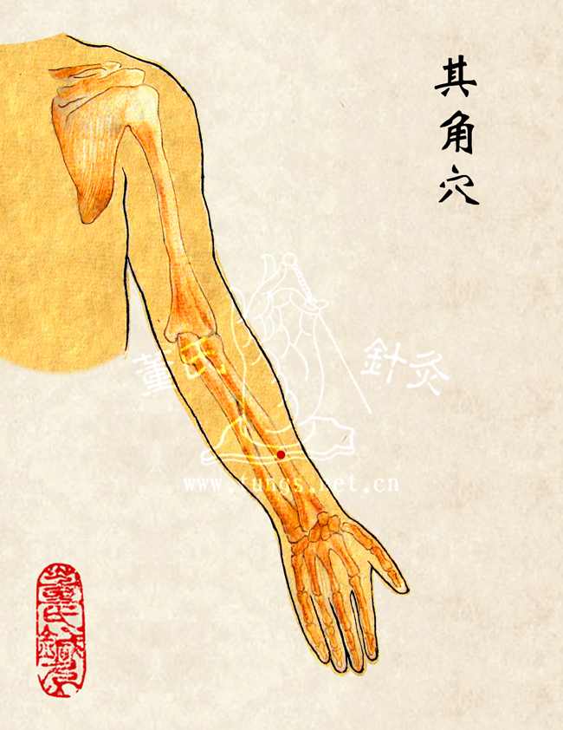
定位；手背橈骨之外側上緣，手腕橫紋正中央上二寸靠內側一寸。 直上二，四寸。 主治；子宮炎、卵巢炎、子宮頸瘤、尿道炎、月經不調、赤白帶下、脫肛、痔瘡痛、膀胱炎。三穴同時下針亦可治婦女性冷感、便秘。
其门其角其正
Qi Men Qi Jiao Qi Zheng
Major functions ；Uteritis、Ovaritis、Fibroid、Urethritis、 Menstrual irregularity 、Leukorrhea、Anal prolapse、Hemorrhoids pain、Bladder infection。Women’s asexuality、Constipation。

Slide 23
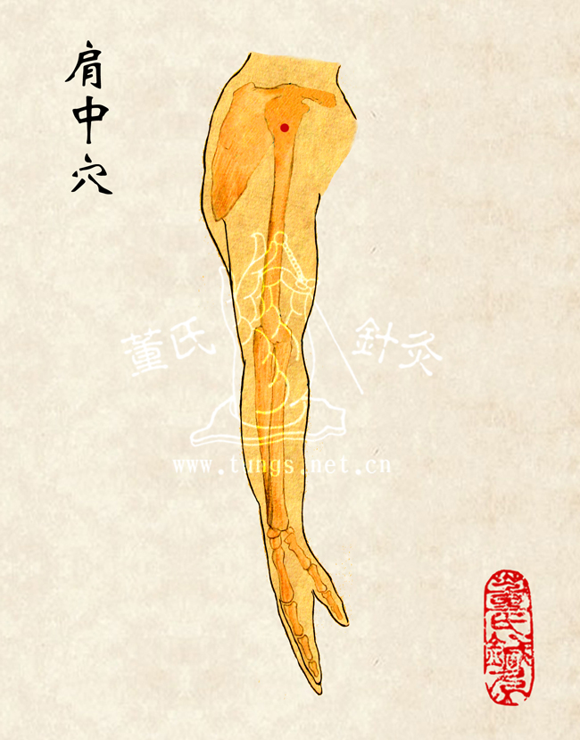
定位；十四經肩顒穴下二寸半。直下二寸。 主治；膝蓋痛、皮膚痛（頸項皮膚病）、小兒麻痹、半身不遂、心跳、血管硬化、鼻出血、肩痛。
肩中 建中
Jian Zhong Jian Zhong
Major functions ；Knee pain、Skin pain（Nuchal dermatosis)、Poliomyelitis、Hemiplegia、Palpitation、Vascular sclerosis、Epistaxis、Shoulder pain。

Slide 24
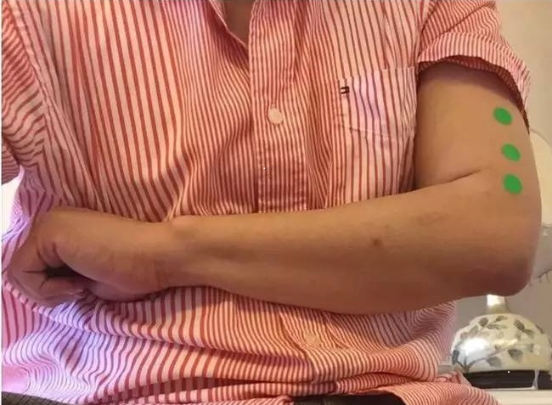
定位；手臂后面，肱骨上正中央、肘横纹直上246寸。 主治；脊椎骨膜炎（骨刺）、退化性脊椎骨增生症、僵直性脊椎不能弯曲症、坐骨神经痛、颈椎骨刺。
正脊 一二三
Zheng Ji 123
Major functions ；Vertebral periostitis（Bony spur）、 Degenerative spondylitis 、 Ankylosis spondylitis 、Sciatica、 Cervical spondylosis。

Slide 25
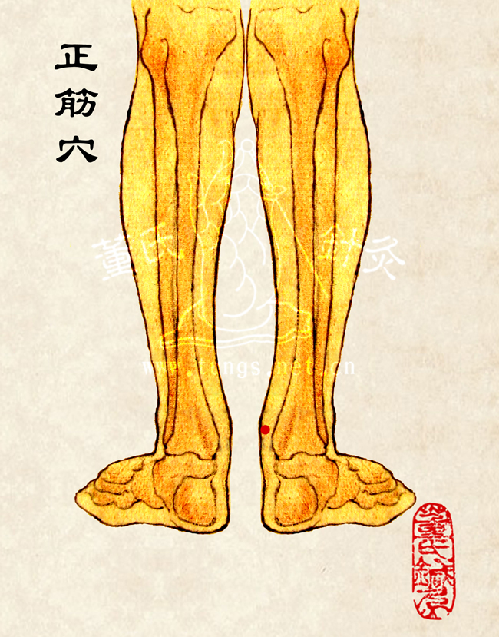
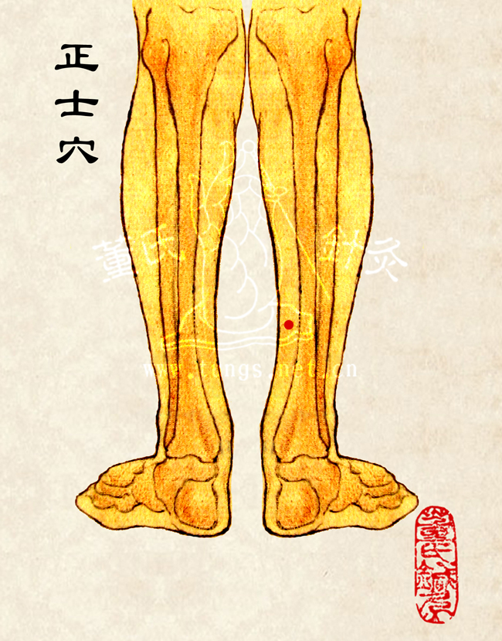
定位；足後跟筋正中央上，距足底三寸五分。 直上二四寸。 主治；脊椎骨閃痛、腰脊椎痛、頸項筋痛及扭轉不靈、腦積水。（針透過筋效力尤佳），體壯者可坐姿扎，體弱者應側臥扎。
正筋正宗正士
Zheng Jin Zheng Zong
Zheng Shi
Major functions ； Vertebral spore pain 、 Lumbar spinal pain 、 Neck tendons pain and Torsional 、 hydrocephalus。

Slide 26
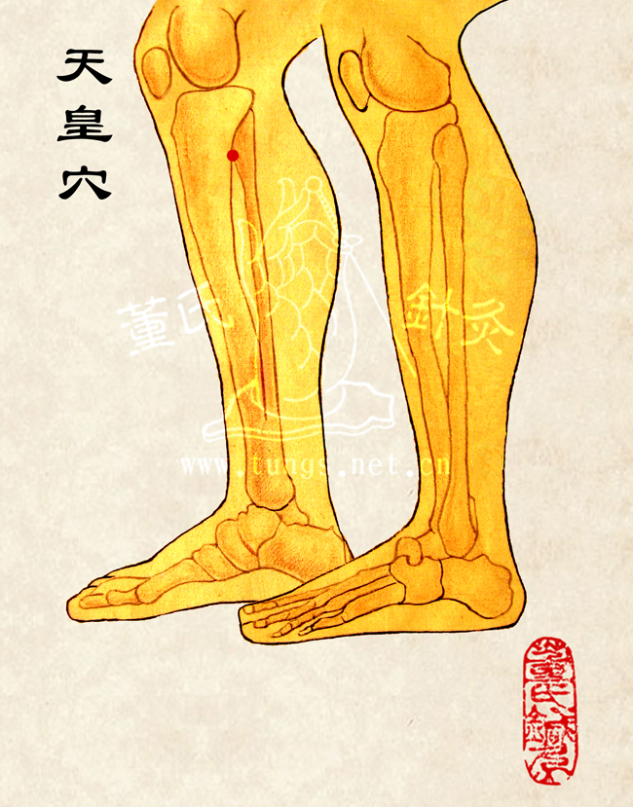
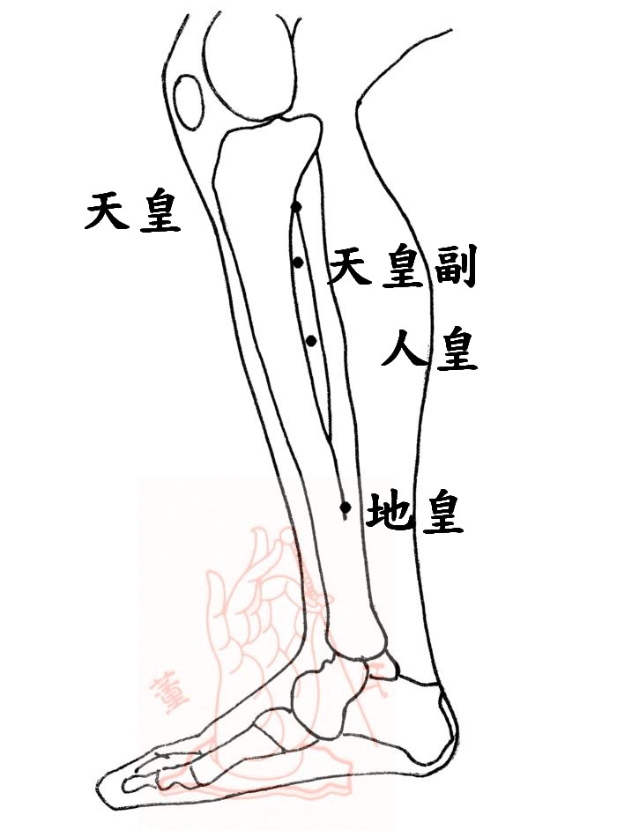
下三皇，腎虧、腎臓炎及糖尿病。孕婦禁針。 人皇，地皇穴 ；胃酸過多、倒食症、眼球歪斜、散光、貧血、神經病，陽萎、尿頻、脖子痛、頭暈、手麻、糖尿病、子宮瘤、月經不調、四肢浮腫。 腎關；定位；陰陵泉下1寸5分処。主治；尿頻，五十肩。
下三皇
Xia 123Huang
地皇
人皇
陷凹處直下一寸
人皇穴直上四寸處。
內踝上三寸五分處。
Major functions;
Xia 123Huang; Kidney deficiency、 Nephrophlogistic, diabetes 。 Forbidden needle for pregnant women 。 RenHuang, DiHuang ； Excessive gastric acid 、Gastroesophageal reflux disease、 Eyeball skew 、 Astigmia 、 Anemia 、 Neuropathy ， Impotence 、 Frequency of urine 、 Neck pain 、 Dizziness 、Hand numb、 Diabetes 、 Fibroid 、 Menstrual disorder 、 Swelling of the extremities 。 ShenGuan； Frequency of urin ， Frozen shoulder 。

Slide 27
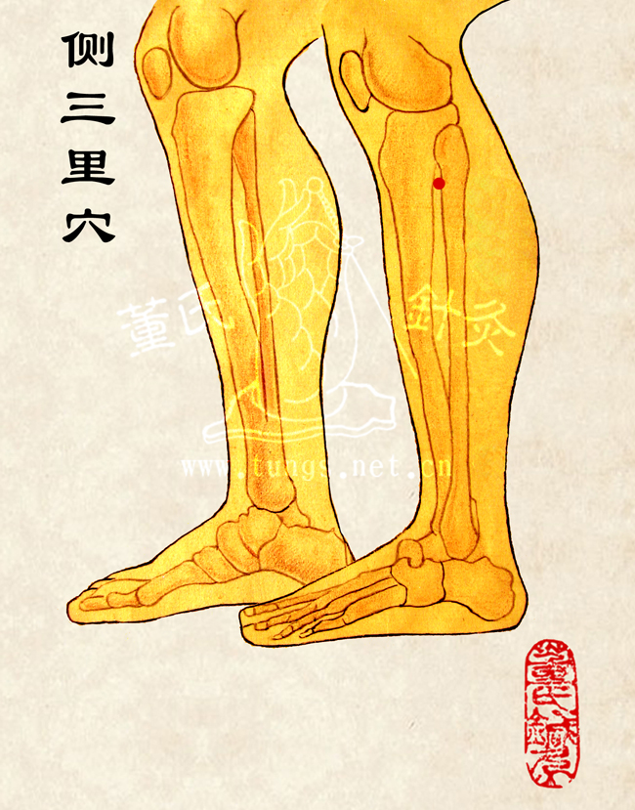
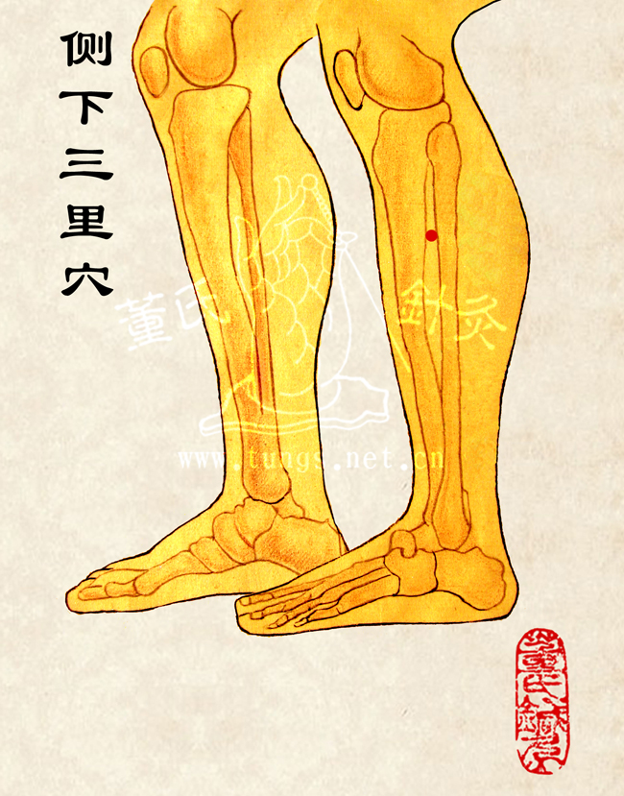
定位；足三里穴外一寸五分。直下二寸。 主治；牙痛、三叉神經痛、偏頭痛、肋間痛，盲腸炎痛。
侧三里 侧下三里
Ce San Li Ce Xia San Li
Major functions ； Odontalgia 、Trigeminal Neuralgia 、 Migraine 、 Intercostal pain ， Appendicitis pain。

Slide 28
定位；外踝骨尖直上三寸向前橫開一寸處。直上二四寸。 主治；甲狀腺腫大（心臟病引起）、眼球突出、扁桃腺炎、口歪眼斜（顏面神經麻痺）、偏頭痛、肝病、腦瘤、腦癌、腦膜炎。喉炎、脾腫大、脾臟炎、青春痘，以及各種良性、惡性腫瘤之常用董氏要穴之一
三重123
San Zhong 123
Major functions ； Goiter （ Heart disease ）、 Proptosis 、 tonsillitis 、 Bell’s palsy （顏面神經麻痺）、 Migraine 、 Hepatopathy 、 Brain tumors 、 Brain cancer 、 Eeningitis 。 Laryngitis 、 Splenomegaly 、 Spleen inflammation 、 Acne and variety of Benign and malignant Tumor

Slide 29
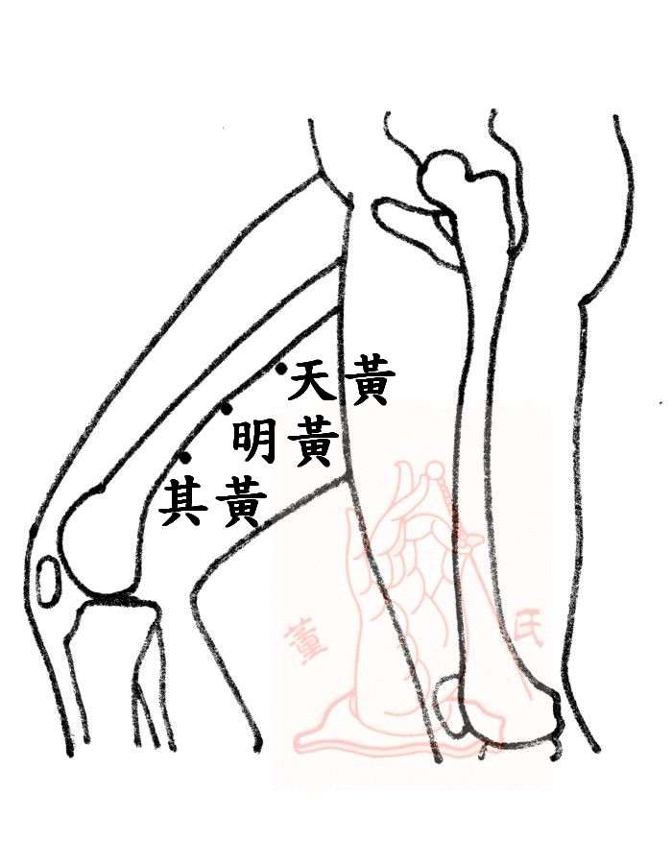
定位；明黃在大腿內側之正中央。天黃在明黃上三寸。其黃在明黃穴直下三寸。 主治；肝硬化、肝炎、脊椎骨膜炎、肝機能不夠引起之疲勞、腰酸、眼昏、眼痛、肝痛、消化不良、白血球症。另外，其黃穴；黃疸病之要穴之一。婦科病之主要配穴，月經週期不順所引起之諸症。
上三黄
Shang 123 Huang
Major functions ； Hepatocirrhosis 、 Hepatitis 、 Vertebral periostitis 、 Fatigue due to inadequate liver function 、 Soreness of waist 、 Blysopia 、 Ophthalmodynia 、 Hepatalgia 、 Indigestion 、 Leukocyte disease 。 In addition ，其黃穴； Main acupoint for Jaundice. Main acupoint for Gynecologic disease caused by menstrual disorder 。

Slide 30
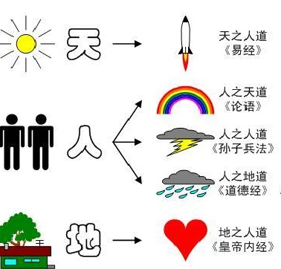
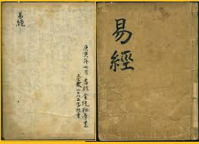
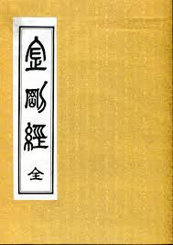
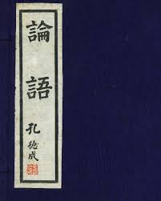
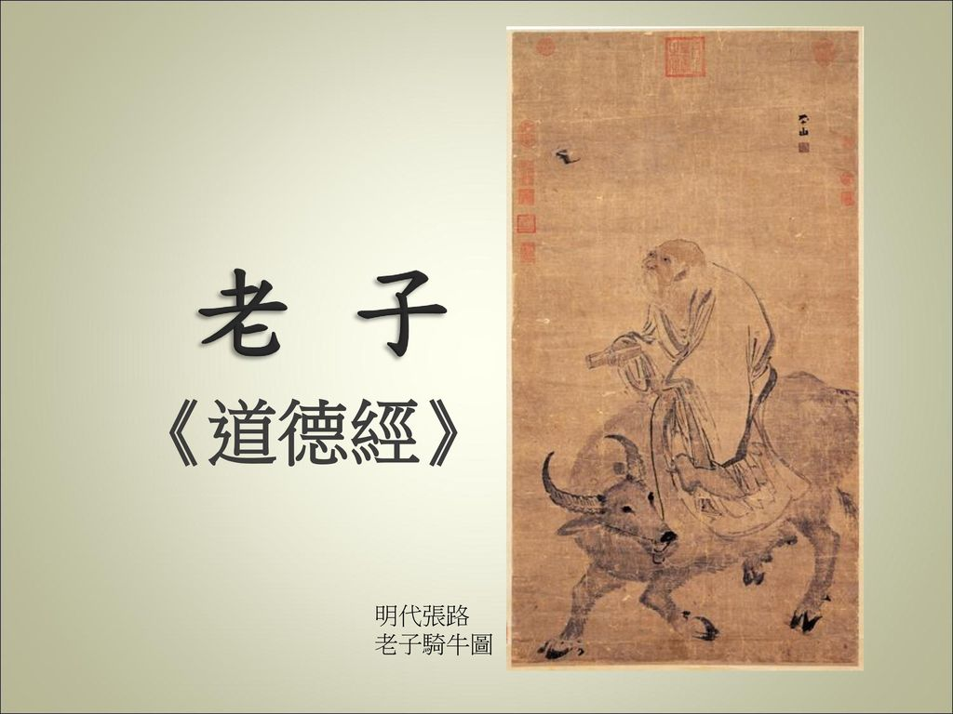
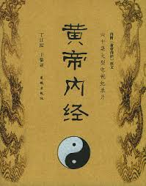
治疗原则 Therapeutic Principles
中國古代哲學
Philosophical concept
Heaven --- Book of changes --- Astronomy, Destiny Science
Human --- Diamond Sutra -- Natural law of human
Analects of Confucius – Human law of human
Daodejing -- Earth law of human
Earth --- The Yellow Emperor's Classic of Internal Medicine
-- Physiology, Pathology , Health care，Acupuncture
天人相应 Correspondence between man and universe
(金剛經)
(論語)

Slide 31
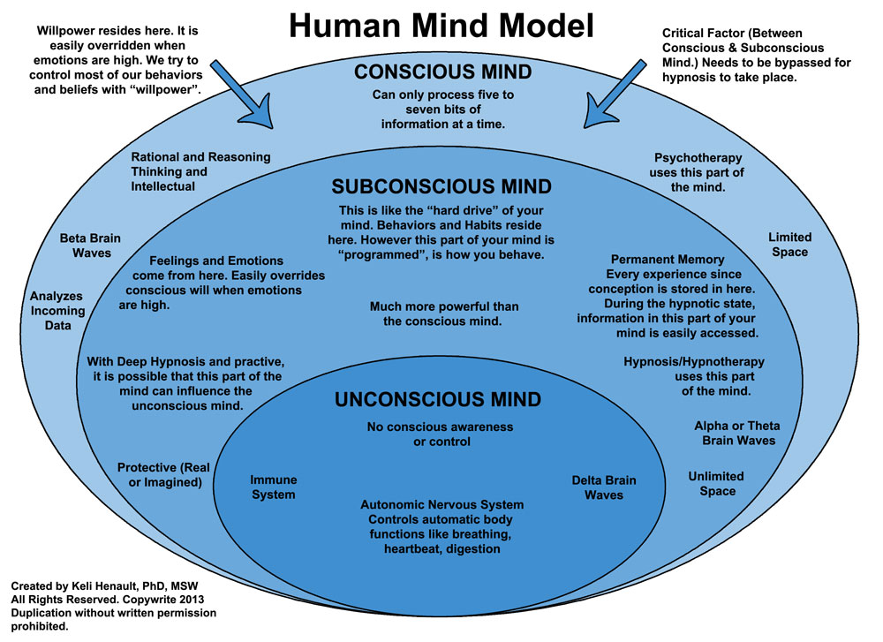
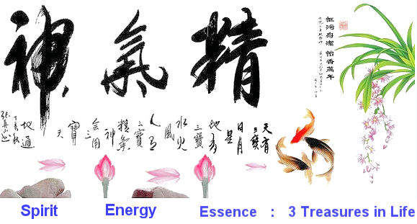
1. 急則治標，缓则之本。
Relieving the secondary symptoms first in treating acute disease
Relieving the primary symptoms in treating chronic disease
靈樞；調氣治神(Regulating qi to treat the mind)
針刺之核心；調氣和治神; 治神則守神,
第一，醫者之注意力。
第二，患者之精神狀態。
凡刺之法, 先必本于神
凡將用鍼, 必先診脈; 理解氣之 盛衰虛實。
得氣 ; 刺之要 氣至而有効

Slide 32
2. 治病求于本 Treatment of disease must concentrate on the principle cause of disease
阴平阳秘 Yin and yang in equilibrium

Slide 33
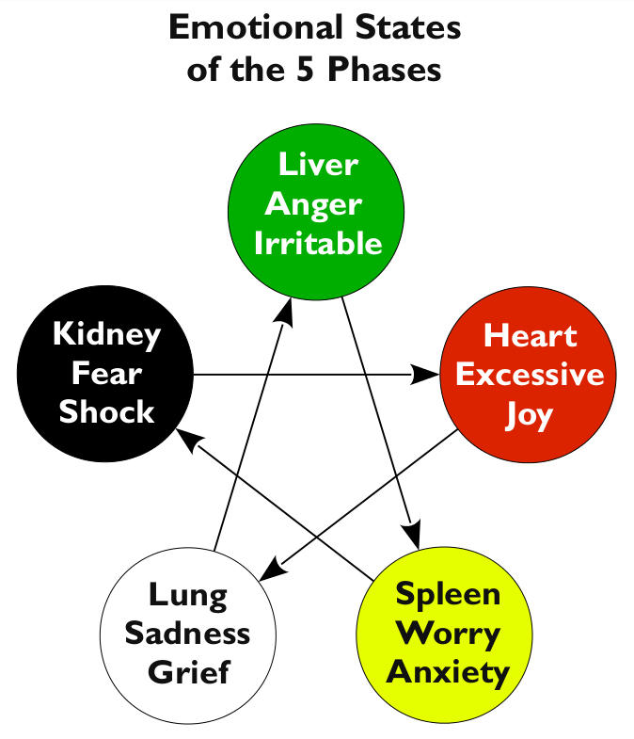
3. 治未病 ； 正气内存 邪不可干；七情
Prevention of disease: Depletion of essence causing deficiency ; Seven emotions
七情內傷 Internal injury of seven emotions ; 仁義禮智信 Five human nature
Courtesy (Considerate of others’ first)
辭讓之心
Humaneness
(Help People with pity)
Sincerity
(DO a good deed to all Creatures)
Justice
(Fair and Square at All situations)
誠意
羞惡之心
惻隱之心
Wisdom
(Distinguish Right or Wrong)
是非之心

Slide 34
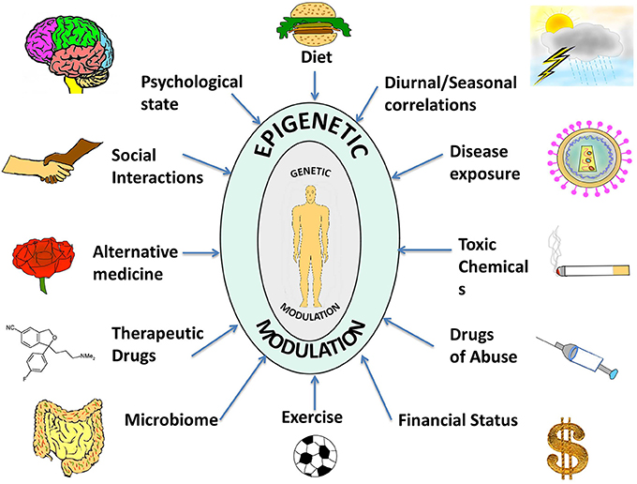
4. 遗传学和表觀遗传学 Genetics and Epigenetics

Slide 35
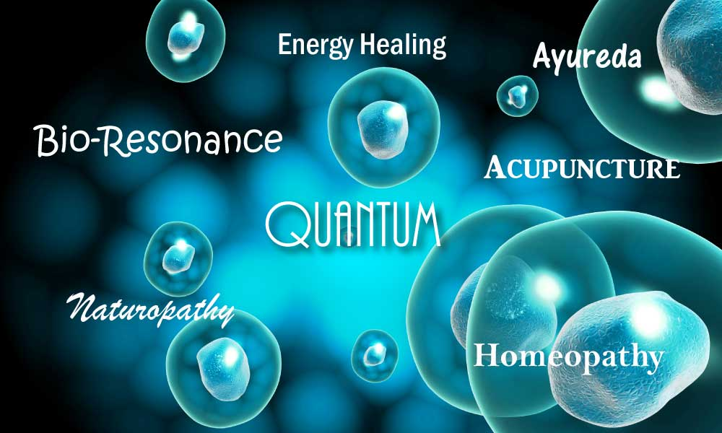
Scientific basis of Chinese Medicine
1. Quantum Medicine and Qi
Ayurveda
AS the development of the Quantum medicine, Western medical scientists found the similarities …

Slide 36
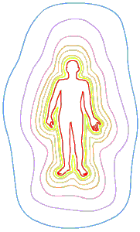
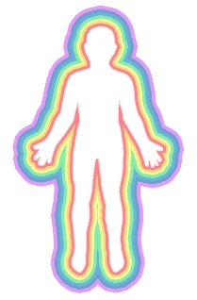
Body and Mind is separated but connected by Quantum Energy Field
Innate Essence
Motion and Variation of Qi
The spirit /Mental Activity
精
气
神
Body
Quantum Energy Field
Mind

Slide 37
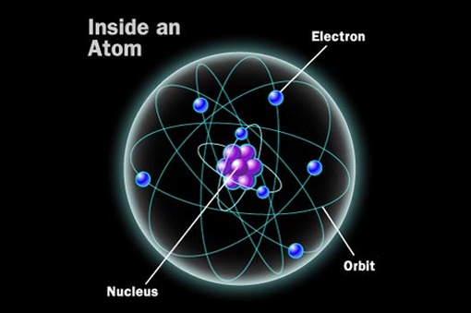
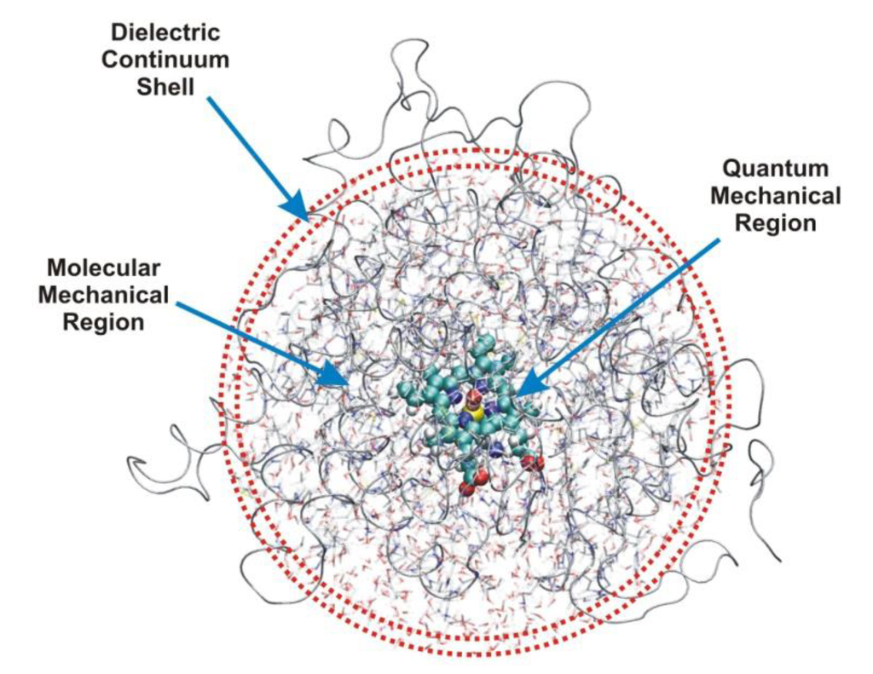
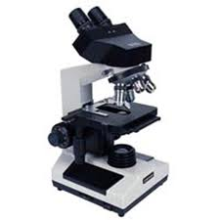
2. Thoughts become Things and The mind is everything,
What you think you become. 一切唯心造, 七情內傷
Atom is the smallest material thing, and all of the creatures are composed of atom.
Inside a atom there is nucleus.
Inside a nucleus there is quantum.
Quantum exists sometimes as material, sometimes as a vibration by a human’s will.
Atom
Quantum

Slide 38
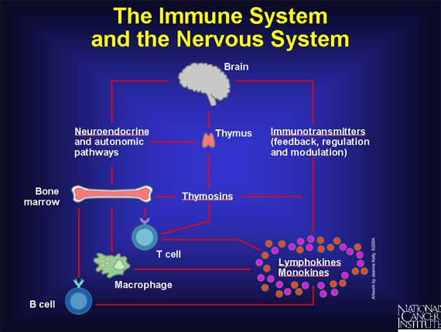
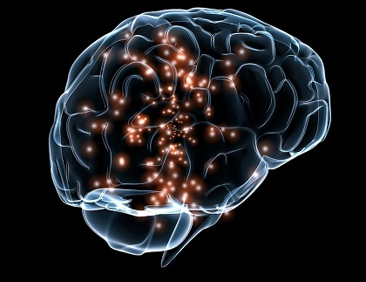
It is a proof of how our thoughts are working in our body!
https://www.youtube.com/watch?v=HNP1EAYLhOs=

Slide 39
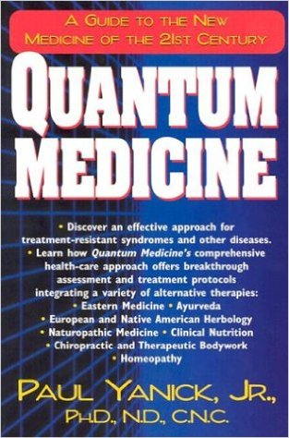
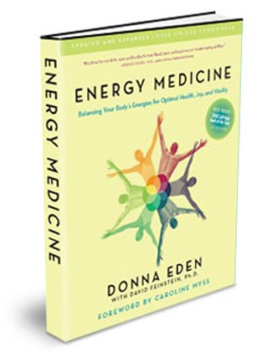

Slide 40
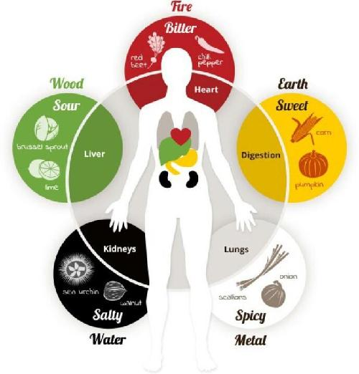
3. Phytochemical and Five color foods

Slide 41
Supply Brain
Black Color
Hormone sys
Kidney
water
Lose weight
White color
Respiratory sys
Lung
Dry
Antioxidant
Yellow color
Digestive sys
Stomach
Mud
Reduce stress
Green color
Immune system
Liver
Wind
Reduce fatigue
Red color
Circulation sys
Heart
Fire

Slide 42
4. Collective unconscious and TaiJi
A New Theory of Consciousness: The Mind Exists as a Field Connected to the Brain
A new theory of the relationship of mind and matter by David J. Bohm
Tao produce one，one produce two，two produce three，three produce all things.
Body
Quantum potential
Mind
Body
Quantum potential
Mind

Slide 43
HUMANS are composed of 60 trillion Cells, Each cell has its own DNA
One cell composed of 100 trillion atoms
If an atom is the same size of a football ground,
an electron is the same size of a football.
So all material things are actually empty!

Slide 44
结论 Conclusion
Mindfulness and
Feelings of Emptiness
If you put down selfishness, you will be able to control your body and mind well.
恬淡虚无，真气从之，精神内守，病安从来

Slide 45
Dropbox If you send me your email address, I'll share the following datas！ My email address is stbundo61@gmail.com
1. 董氏奇穴针灸学
2. 董氏奇穴处方学
3. 董氏针灸正经奇穴学
4. 董氏图谱
5. 中医医疗技术手册
6. Advanced Tung Style Acupuncture(董氏倒馬針刺療法)

